Slide 1
Predictive Analytics for hospitals
Name: Ali abdelmeneam abdel karim
ID: 21510563
Supervisor : Dr. Amira abdo
TM471-part A

Slide 2
Introduction
01.
Related Applications
04.
02.
Project Idea
05.
Software & Hardware Requirements
Project Problem
03.
06.
UML Diagram
Overview of the Project Proposal
Review of Existing Solutions and Approaches
Description of the Project Concept
Overview of Required Tools, Technologies, and Infrastructure
Identification of the Problem Statement
Explanation of UML Diagrams Used in the Project

Slide 3
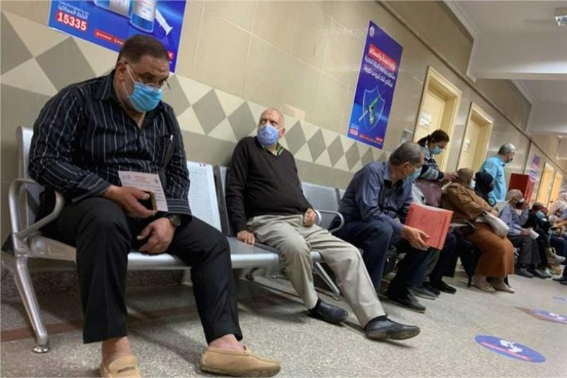
Introduction
Challenges in hospital managment:
Overcrowding leads to longer wait times
unpredictable admissions rate
Why Predictive Analytics?
reduce resource wastage
reduce wait times

Slide 4
Hospitals often face difficulties in managing bed occupancy rates due to the unpredictable nature of patient admissions. Overcrowding leads to extended wait times and stress on healthcare workers, while underutilization results in wasted resources and financial inefficiencies.
The solution:
A predictive analytics system is required to forecast bed occupancy trends accurately. This system can enable hospital administrators to allocate resources effectively, improve patient outcomes, and enhance operational efficiency.
Problem statement

Slide 5
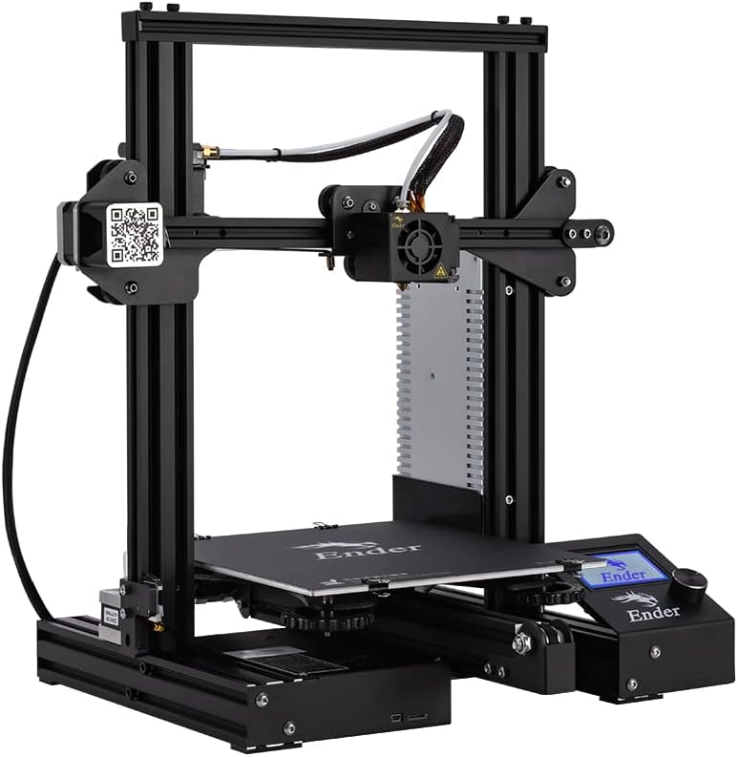
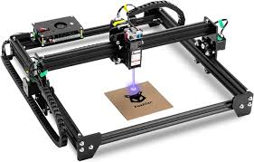
Related Applications
3D Printing
3D printing involves creating physical objects by depositing material layer by layer based on a digital design
Laser Engraving
Laser engraving and cutting machines use high-powered lasers to etch or cut through materials like wood, acrylic, and metal

Slide 6



Software Requirements
Arduino Integrated Development Environment (IDE)
For a CNC plotter pen system using Arduino,
the software requirements typically include:
Inkscape can generate design files compatible with the system.
GRBL driver acts as an interpreter for G-code commands

Slide 7
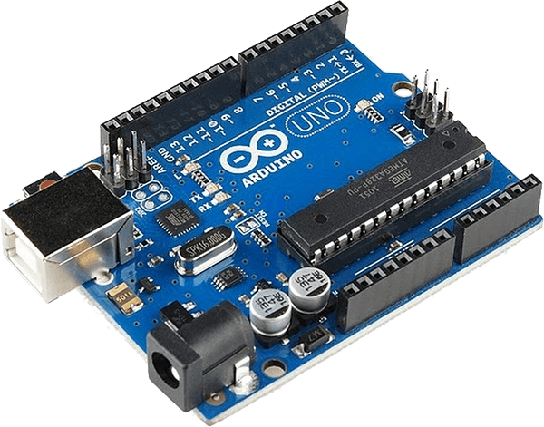
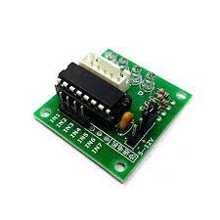
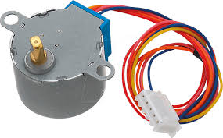
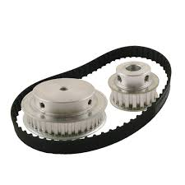
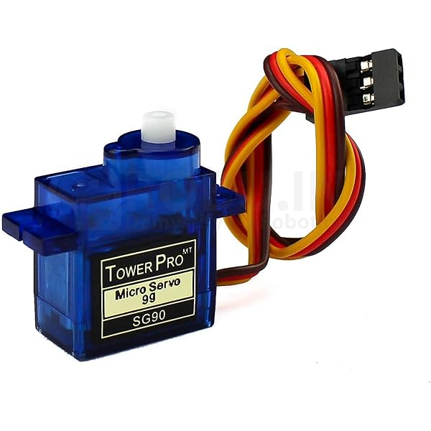
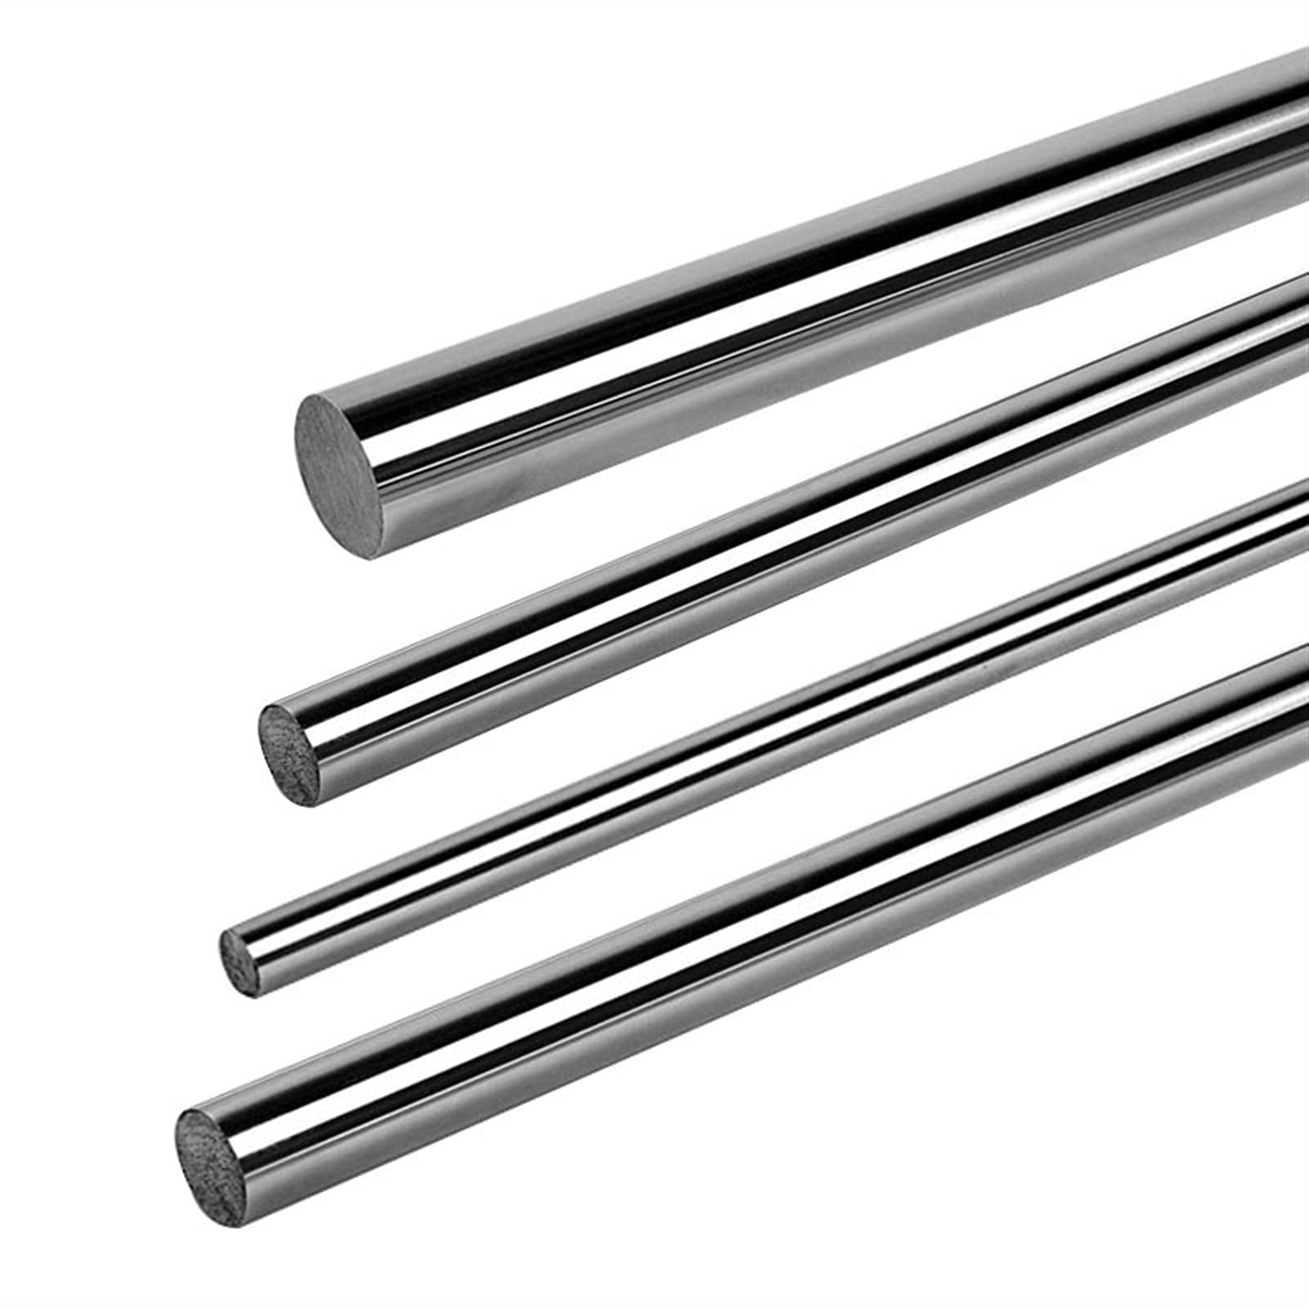
Hardware Requirements
Ardunio UNO
2x ULN2003
Driver
2x 28BYJ-48
Servo Motor
Stainless Steel Rod
Timing Belt Pulley

Slide 8
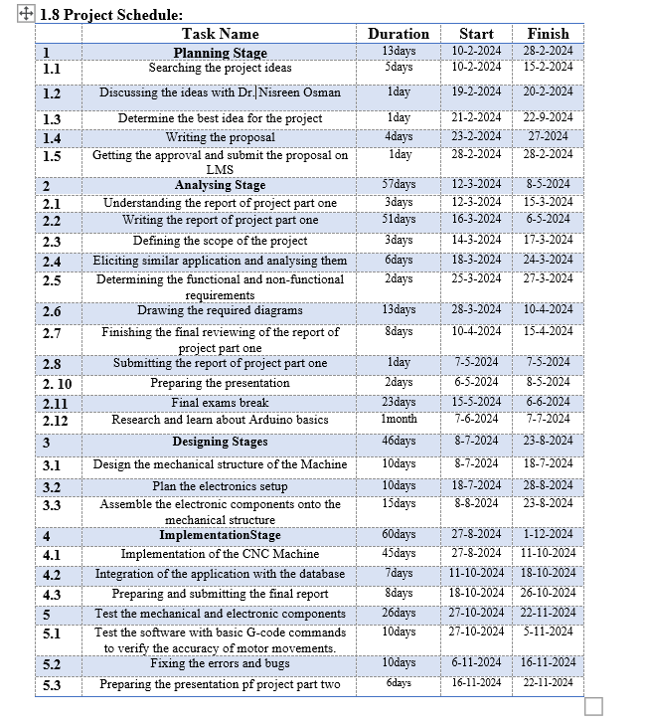
Time schedule

Slide 9
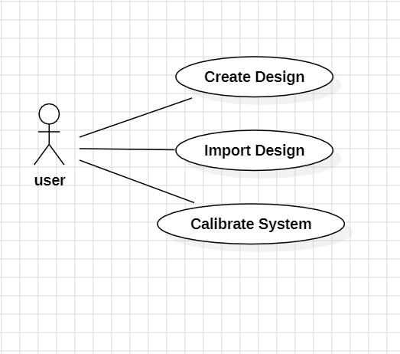
Use Case Diagram

Slide 10
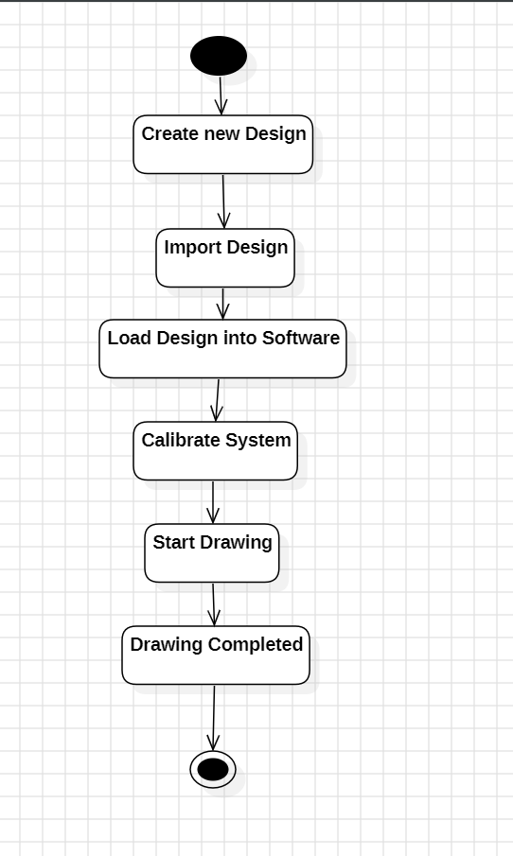
Activity Diagram

Slide 11
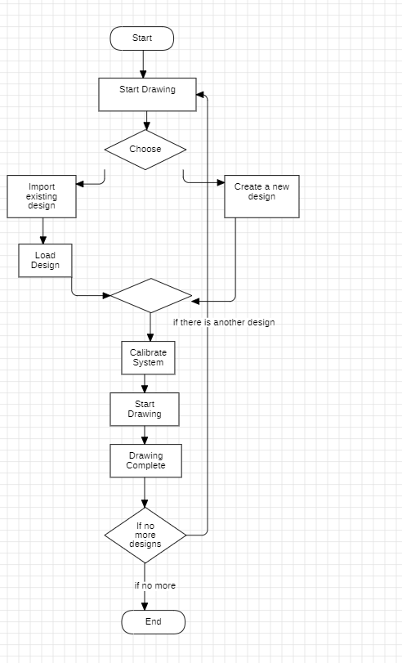
FlowChart Diagram

Slide 12
Thank you

